Slide 1
Synchronization Overhead Testing
Ronald Maule

Slide 2
Table of Contents
Testing overhead time for the following:
Atomic variable <stdatomic.h>
Conditional Variable <pthread.h>
Mutex <pthread.h>
Semaphore <dispatch/dispatch.h>
Spinlock <pthread.h>
Measuring run time of each with a simple example
Excluding conditional variables because they are used to solve a specific problem
Test how increasing the number of threads impacts run time

Slide 3
Overhead Testing
Iterating a variable in a critical section

Slide 4
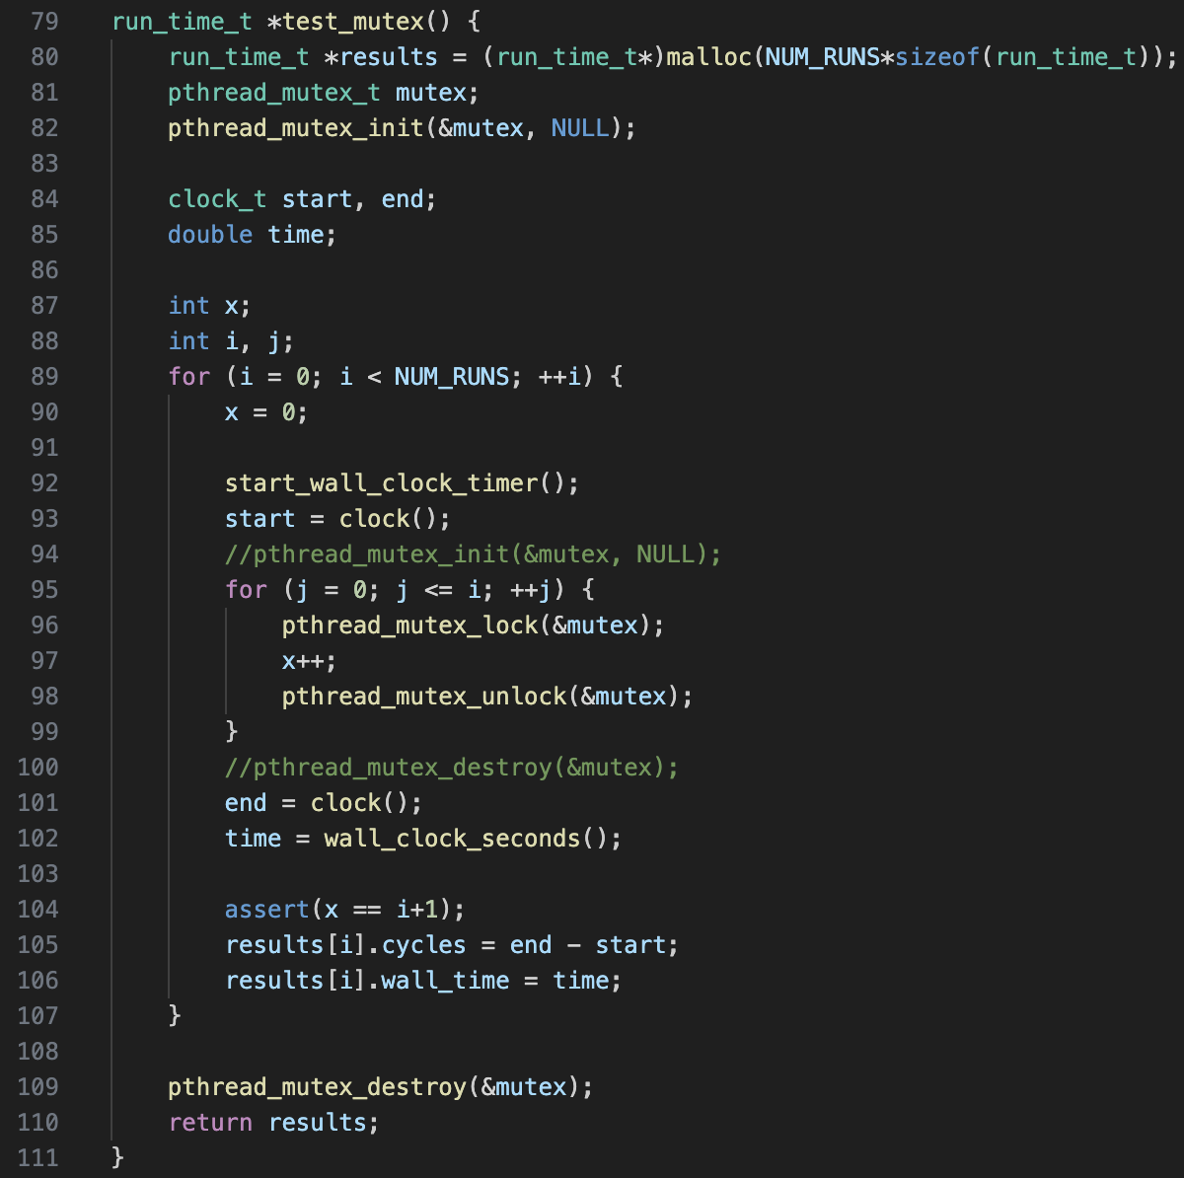
Method
Increment x in a loop
Time this for one iteration, then two iterations, then three iterations, etc.
Done up to 10,000 iterations
Measure number of CPU cycles
Tested with and without initializing a new object for each run
Compiled with –O0 to remove optimizations

Slide 5
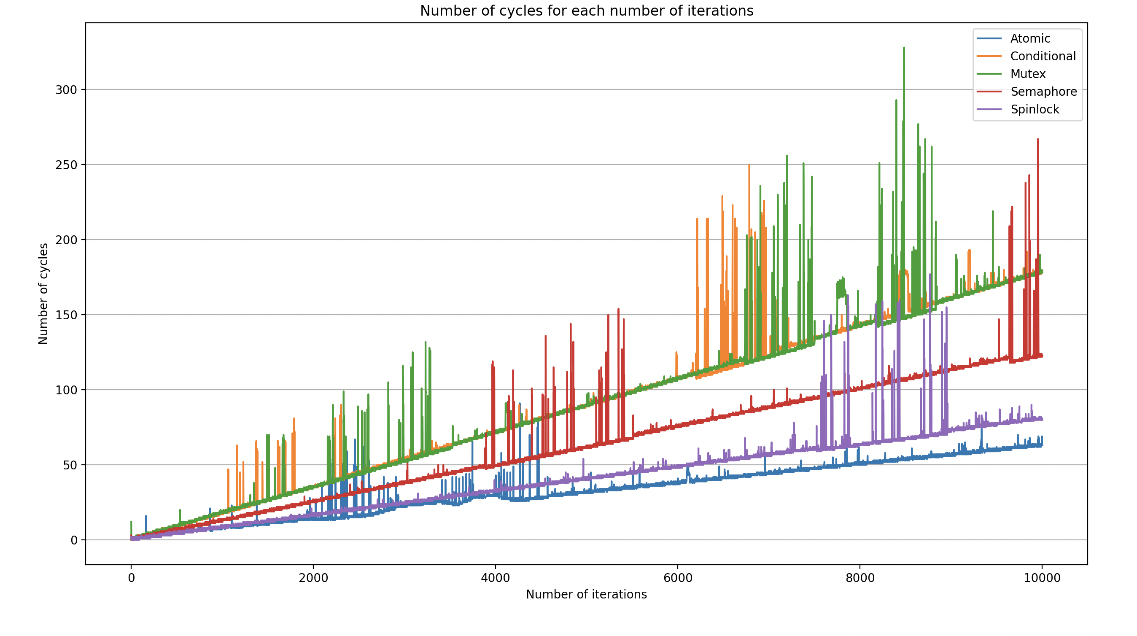
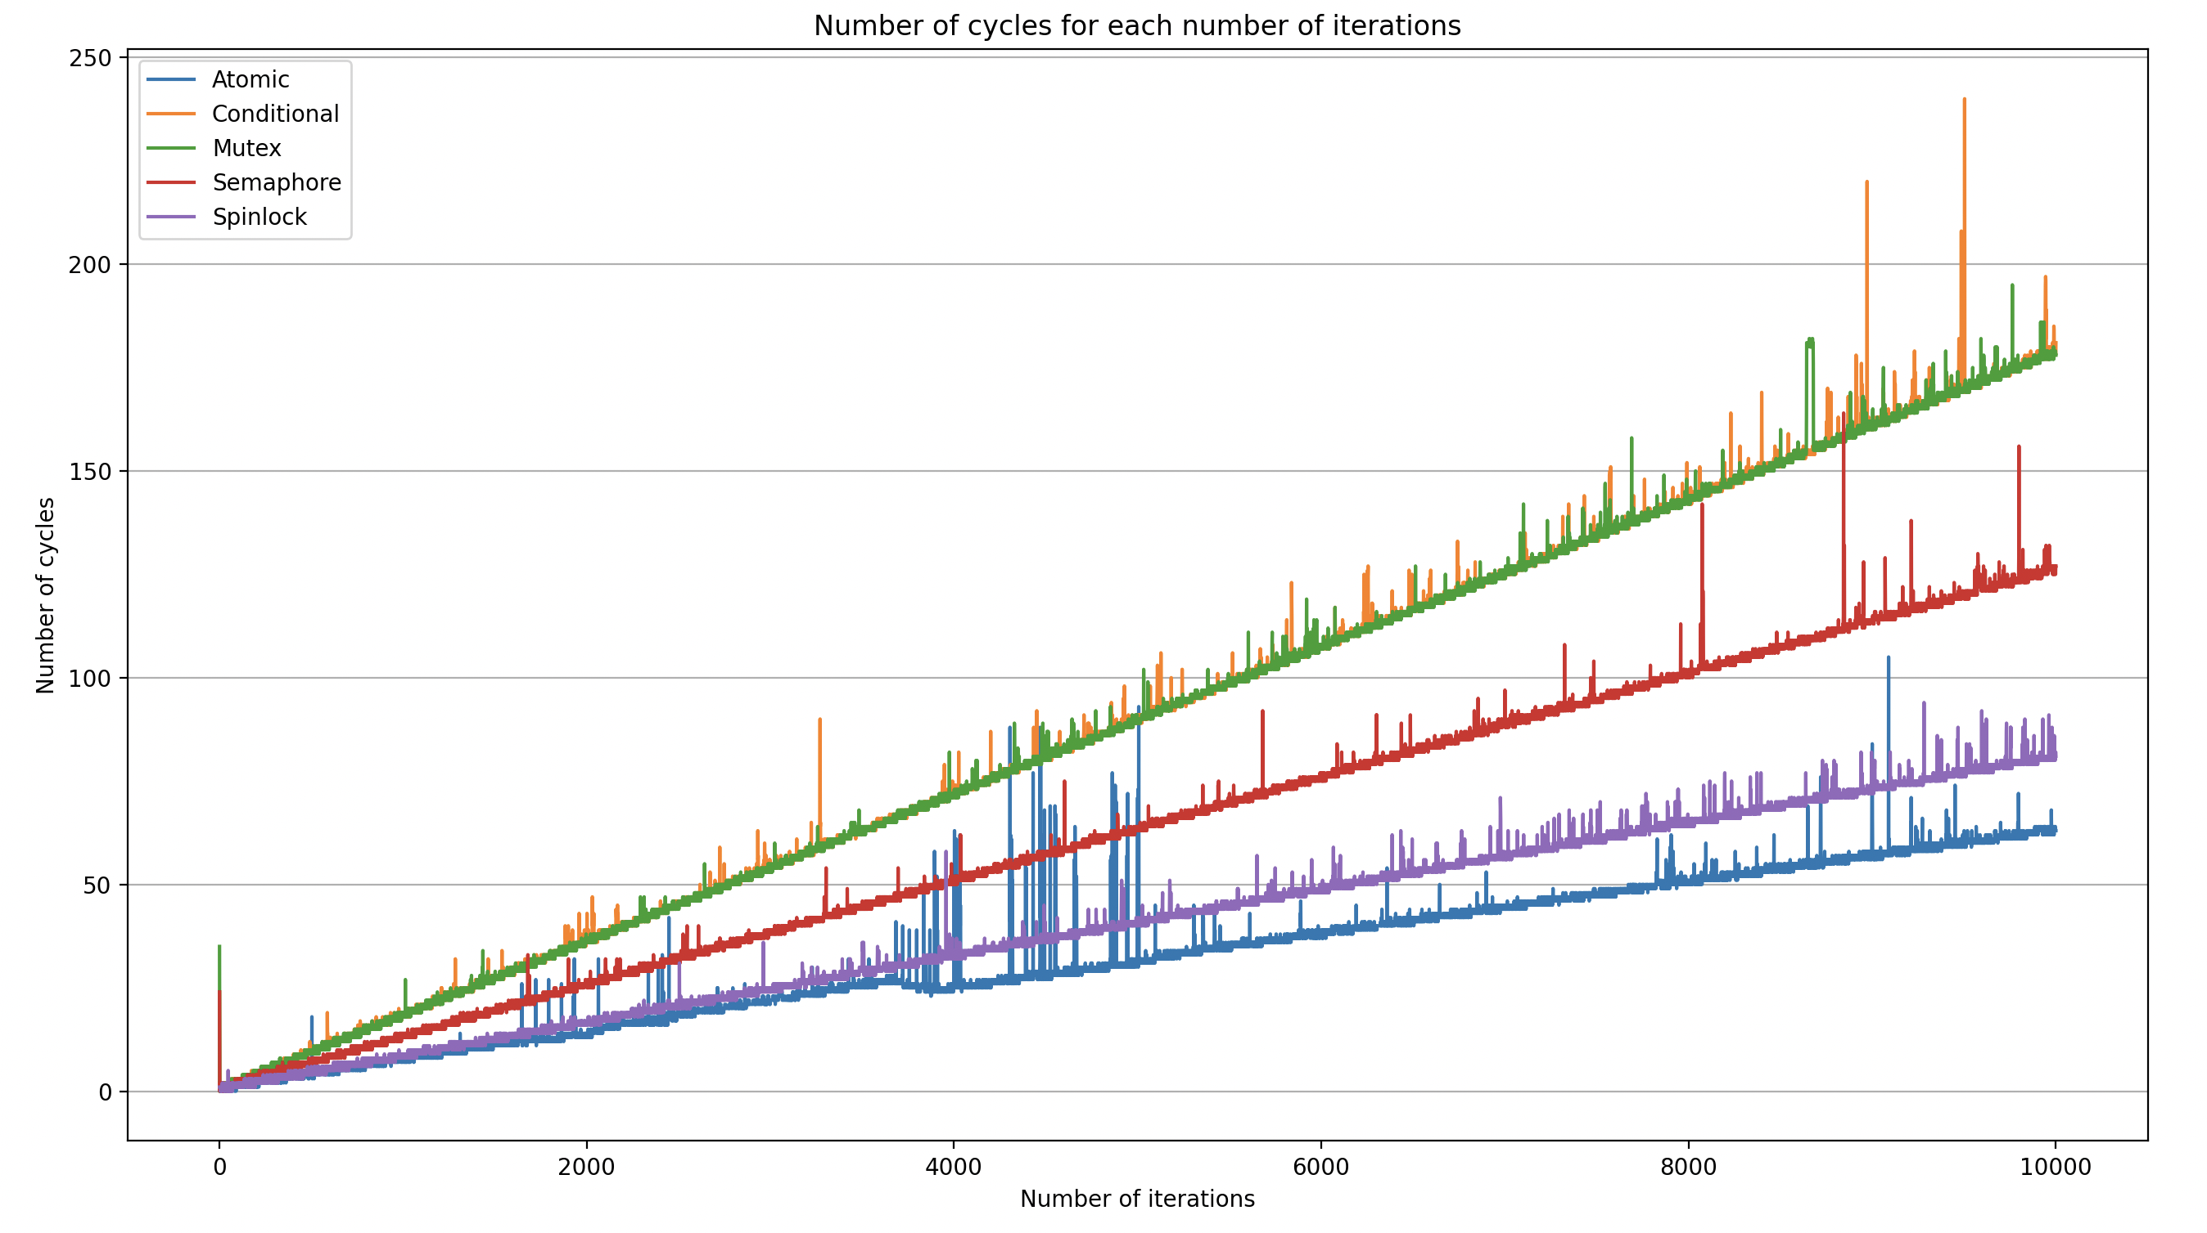
Results
Single Initialization
Multi Initialization
More susceptible to noise
Higher cost for first run

Slide 6
Results (first iteration)
Single Initialization
Multi Initialization
Atomic: 0.000031 seconds
Conditional: 0.000001 seconds
Mutex: 0.000013 seconds
Semaphore: 0.000004 seconds
Spinlock: 0.000002 seconds
No initialization
Conditional: 0.000026 seconds
Mutex: 0.000036 seconds
Semaphore: 0.000024 seconds
Spinlock: 0.000001 seconds

Slide 7
Simple example
Adding number in an array

Slide 8
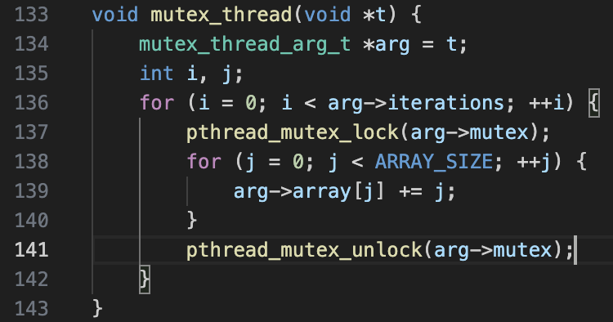
Method
Two threads reading and writing integers in an array
Critical section contains one pass through the array
Computed average time over 1,000 runs
Conditional variables not tested
They solve a specific problem
Not comparable to other methods
Compiled with –O0 to remove optimizations

Slide 9
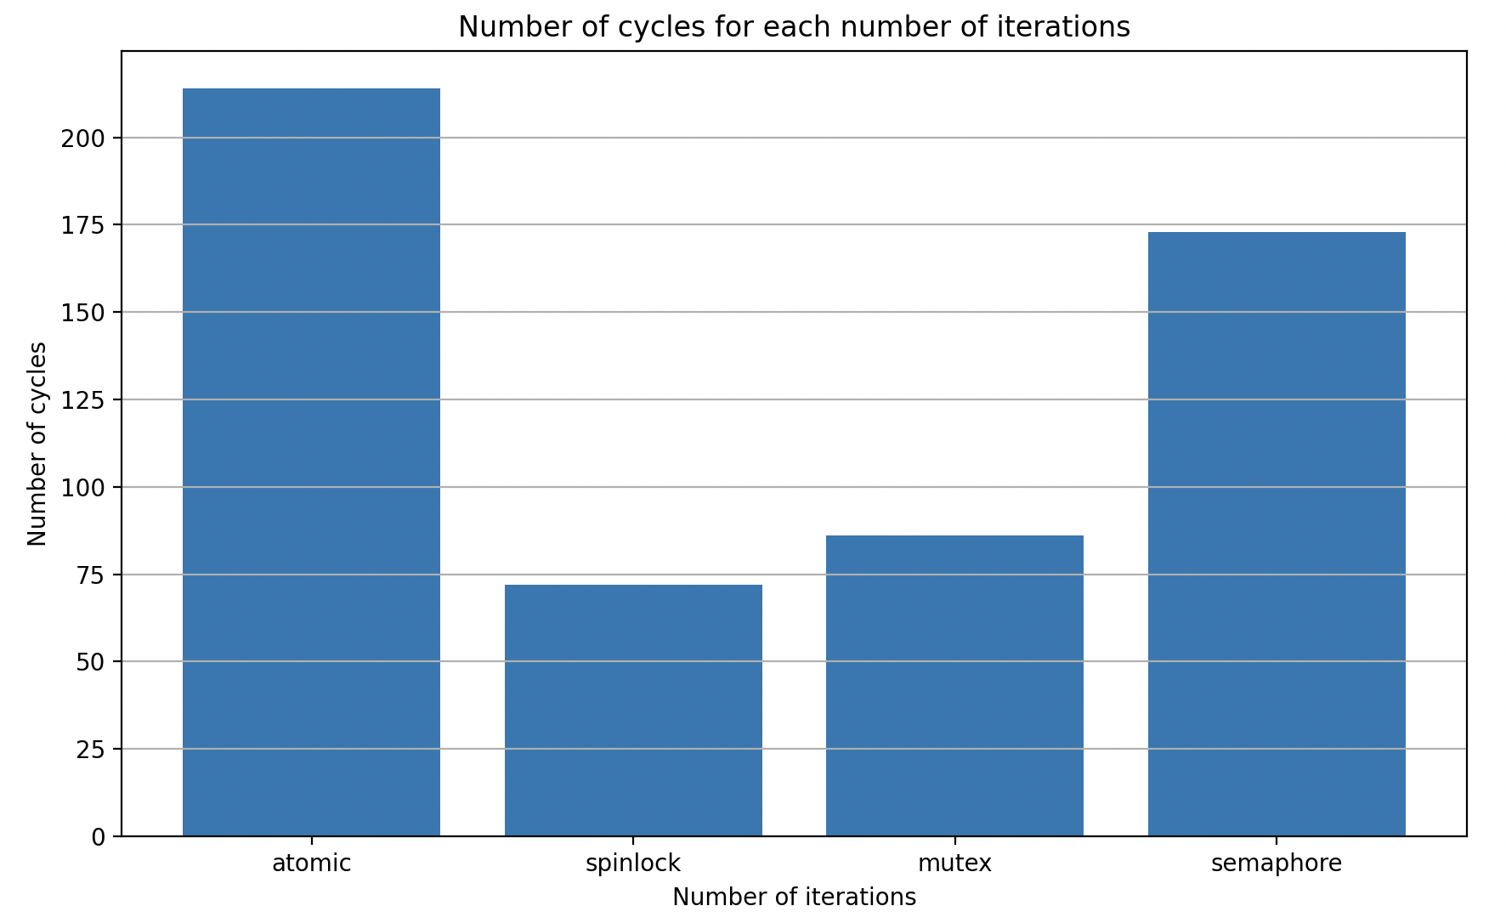
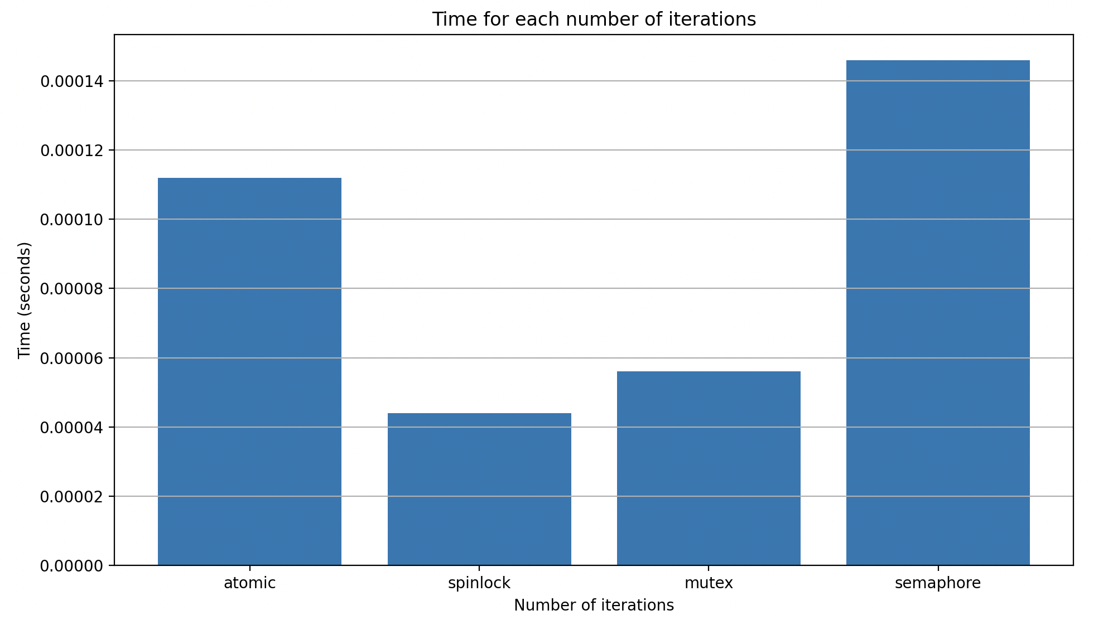
Results
Cycles
Time
Atomic > Semaphore
Atomic < Semaphore

Slide 10
Thread testing
Matrix multiplication with threads

Slide 11
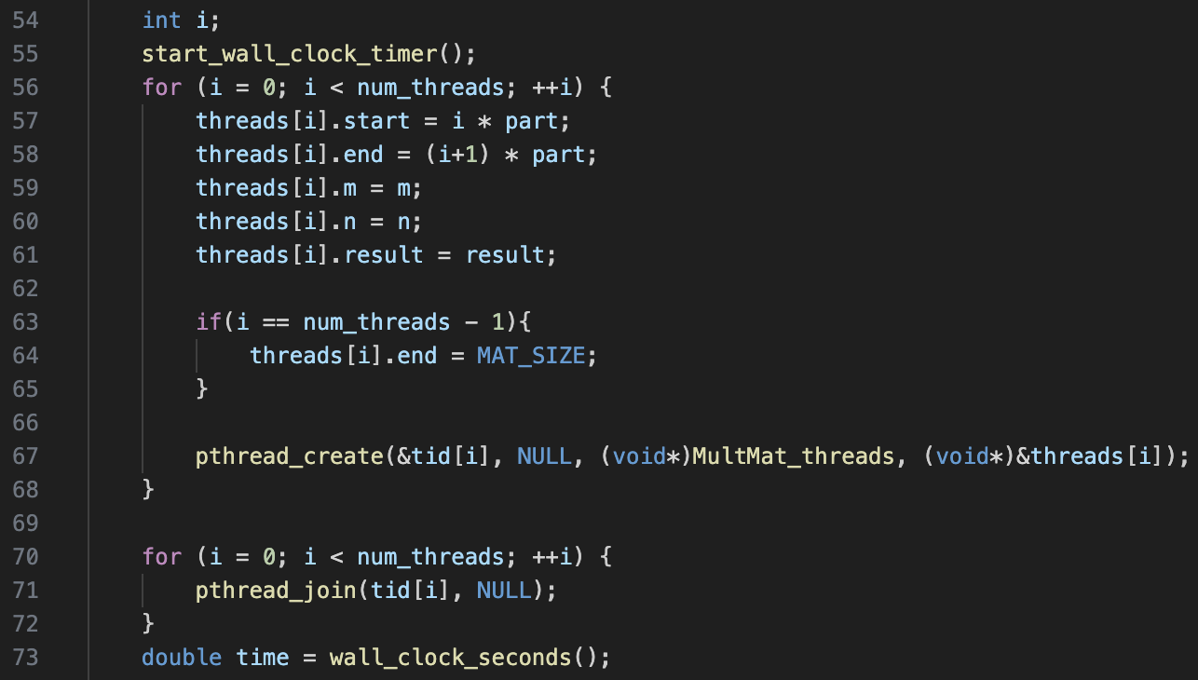
Method
Measure time to multiply two randomly generated 1000x1000 matrices
All tests use same matrices
Done with 1-15 threads on computer with 6 cores
See how number of threads impacts run time
Compiled with –O0 to remove optimizations

Slide 12
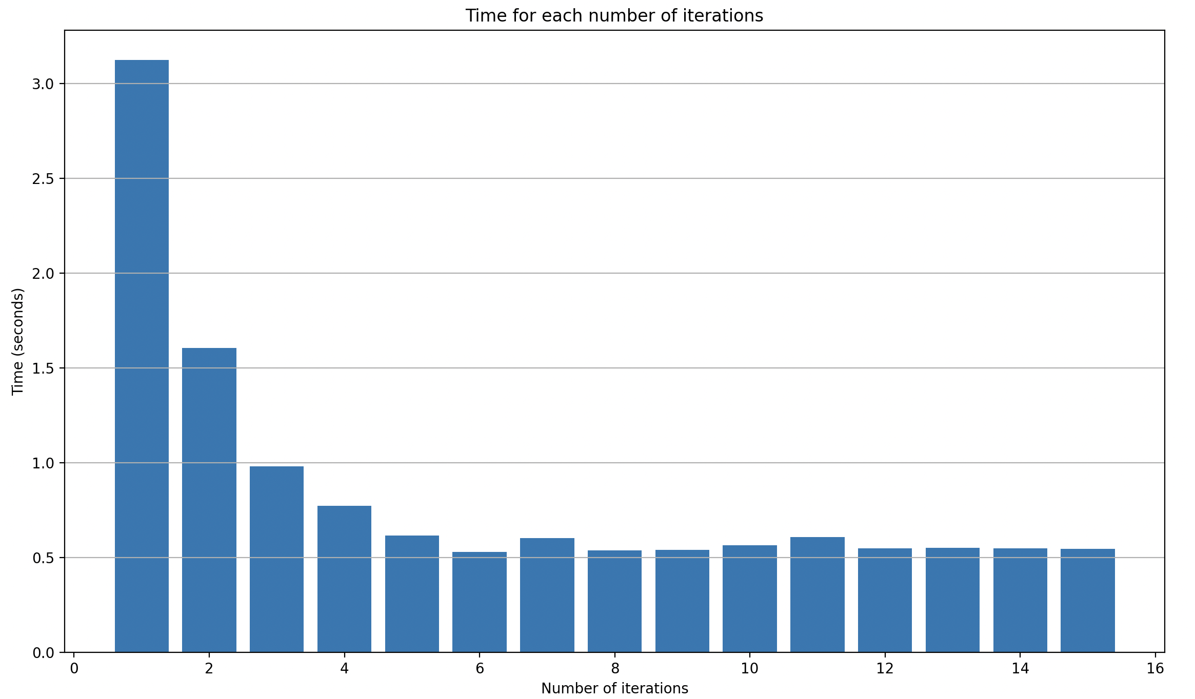
Results
Time decreases as expected
2 threads is half of 1 thread, 3 is a third, etc..
At 6 threads it levels out and there are no longer improvements

Slide 13
Thank you

